Slide 1
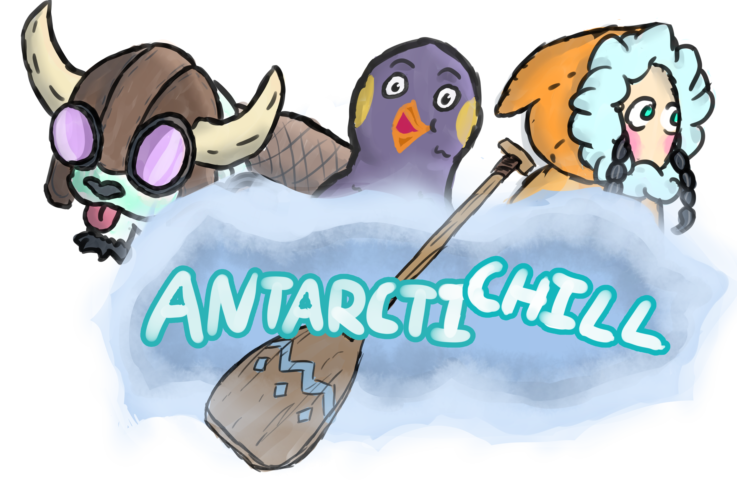
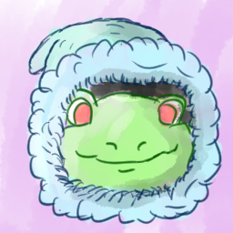


Slide 2
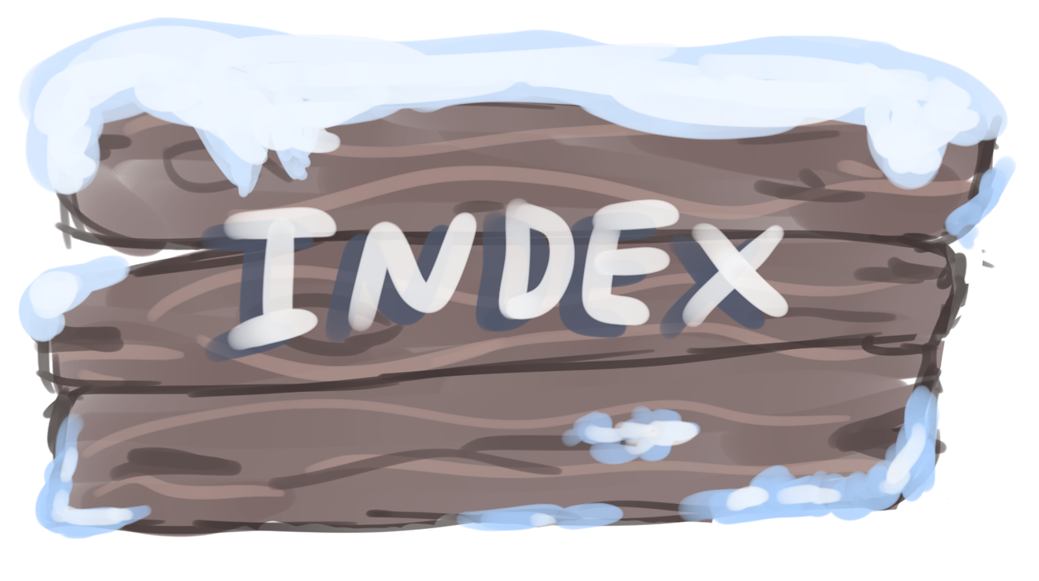
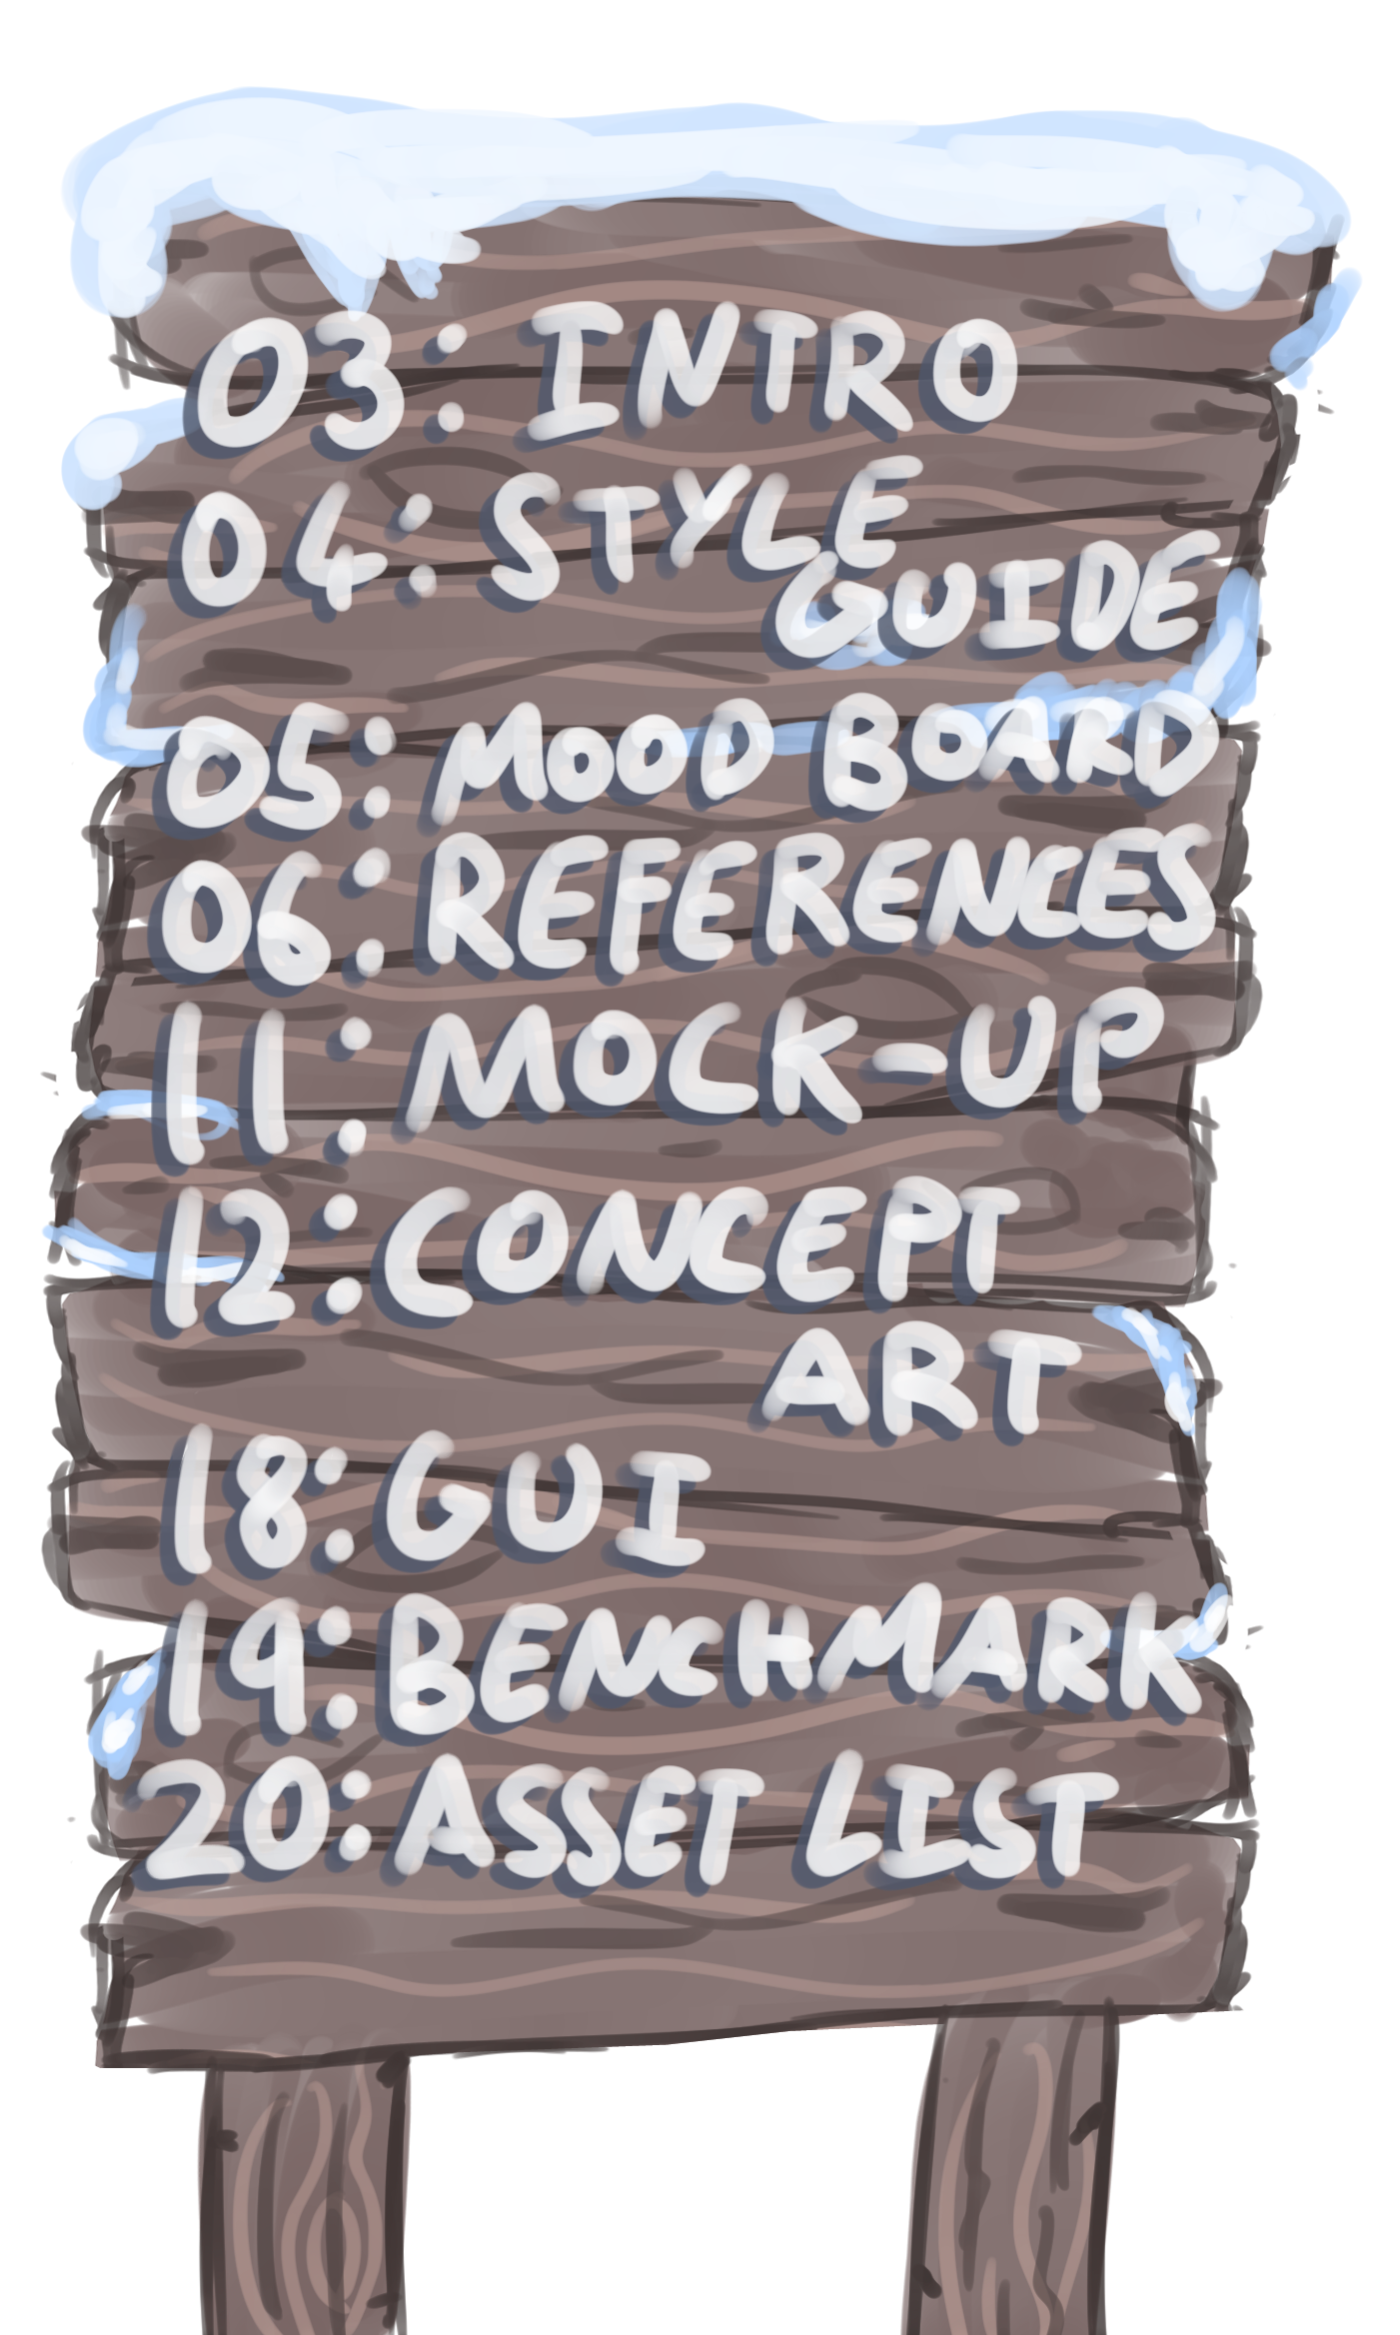

Slide 3
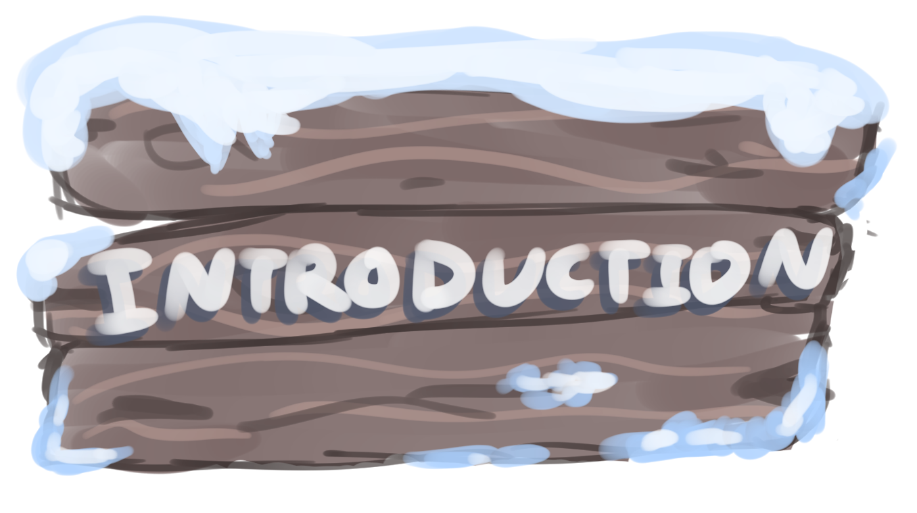
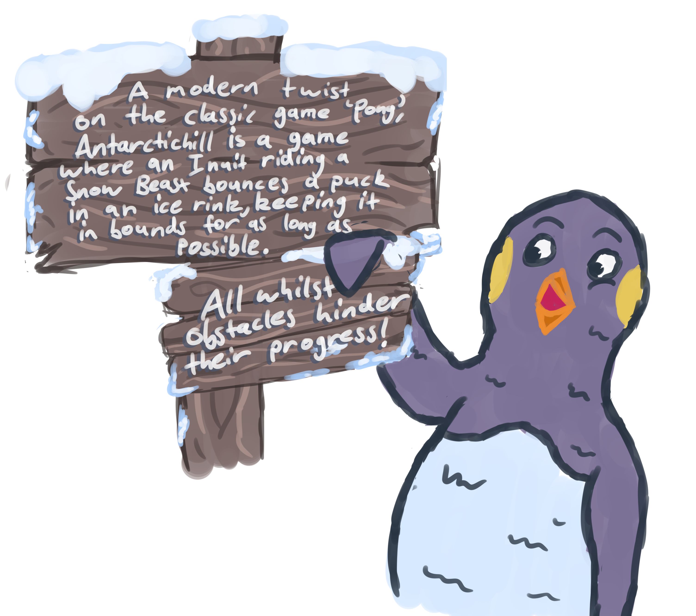
Team members | Anna Ross​ | Cody Smith ​ | Daniel Sohler​ | Benjamin Scott​ | Joshua Spence​
Roles | 3D Artist​ | 3D Artist​ | Designer​ | Programmer​ | Designer​

Slide 4



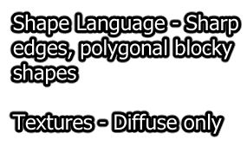
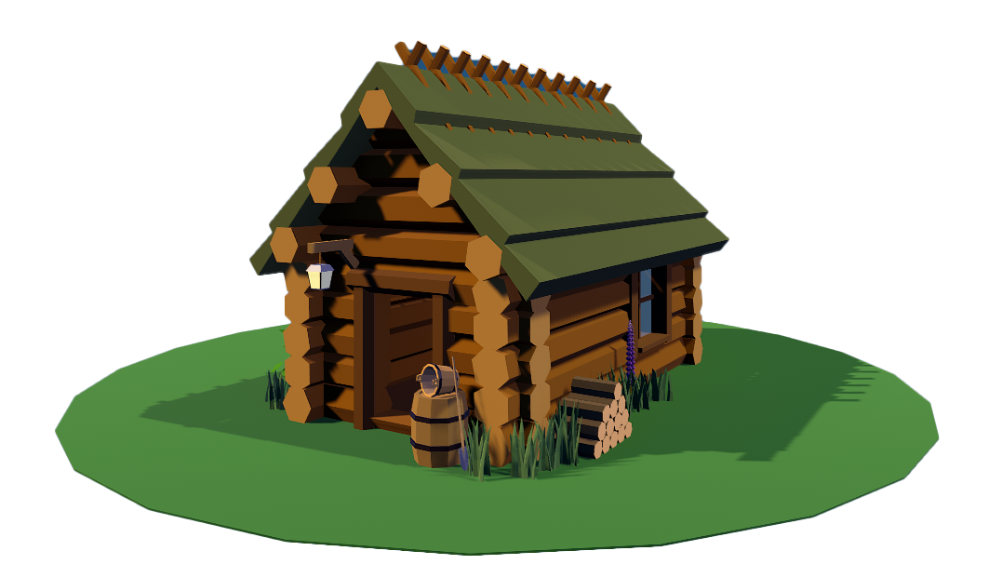
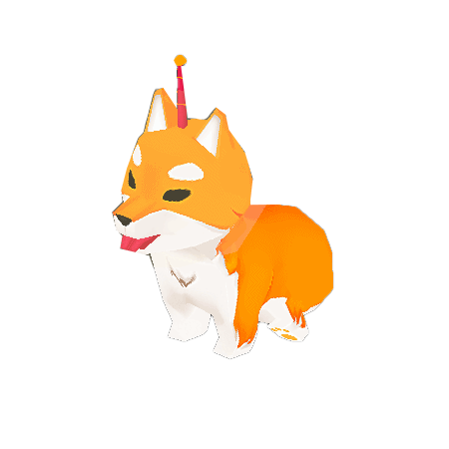
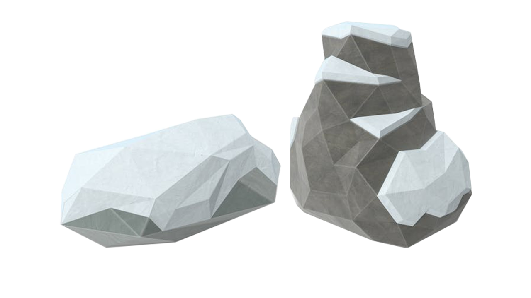
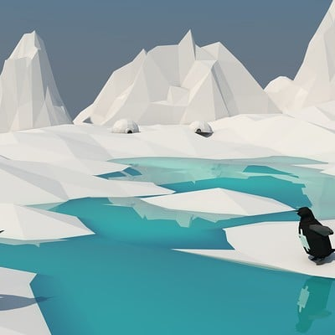
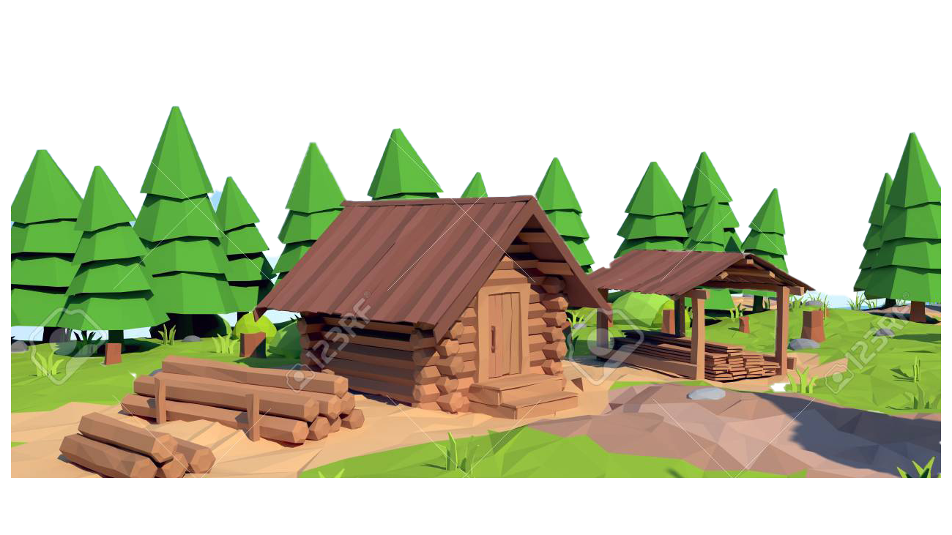
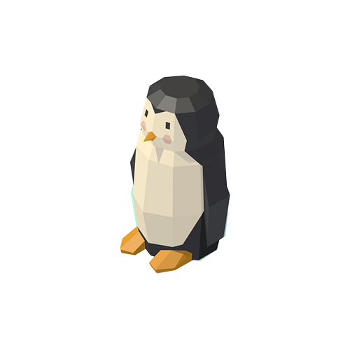
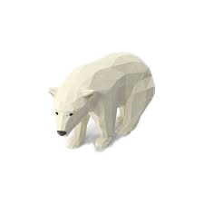
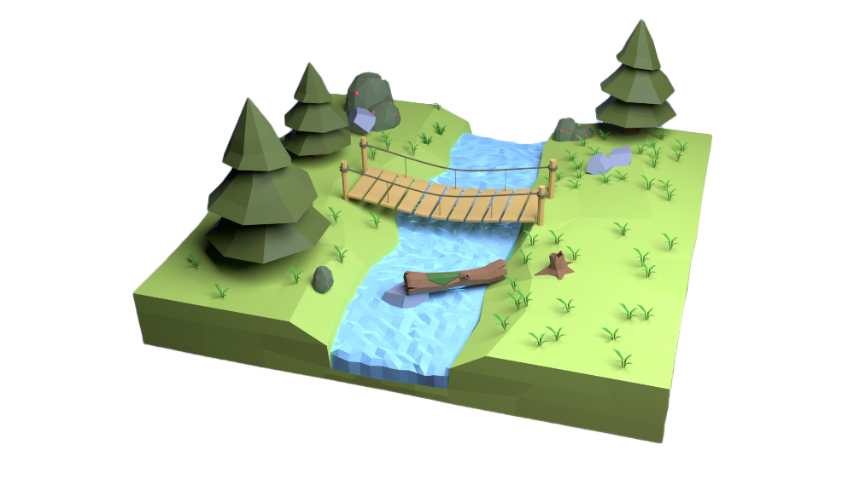
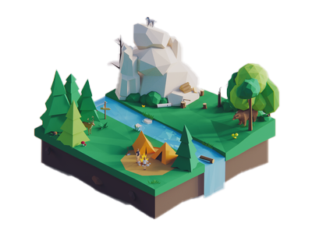
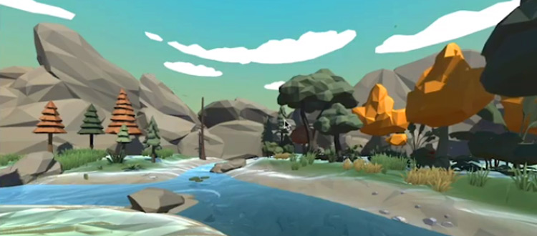
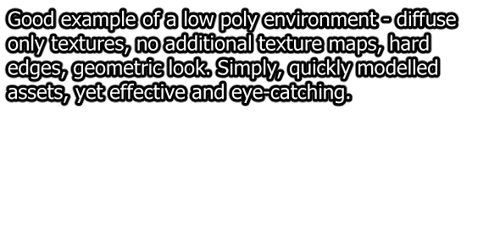

Slide 5
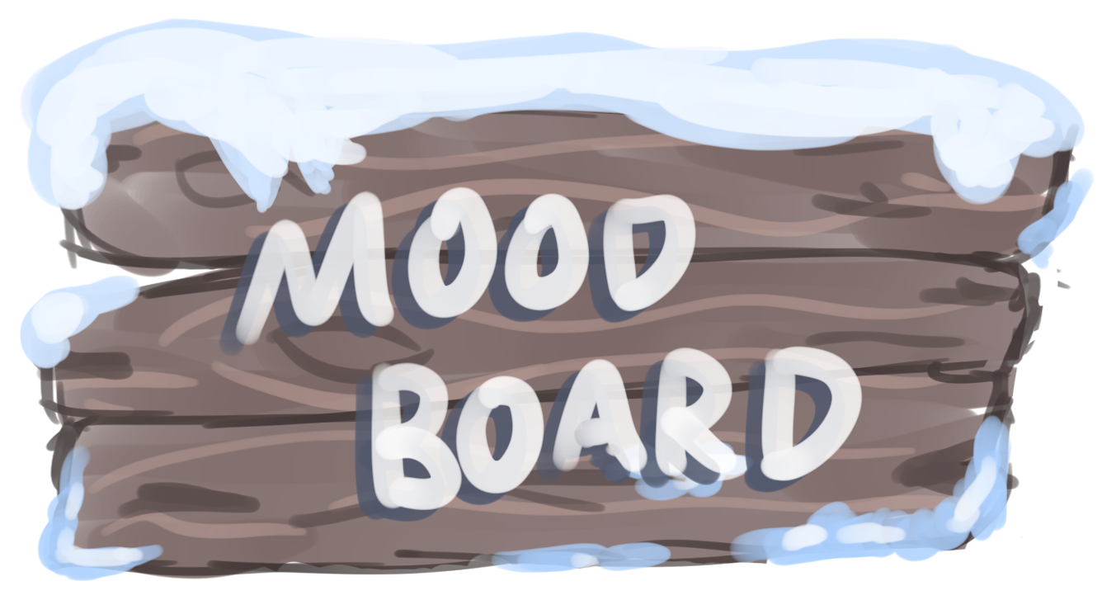
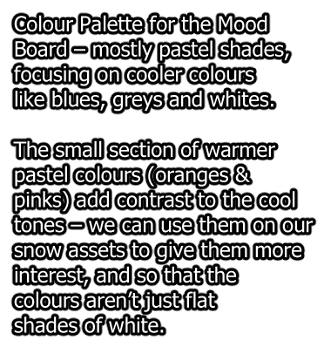

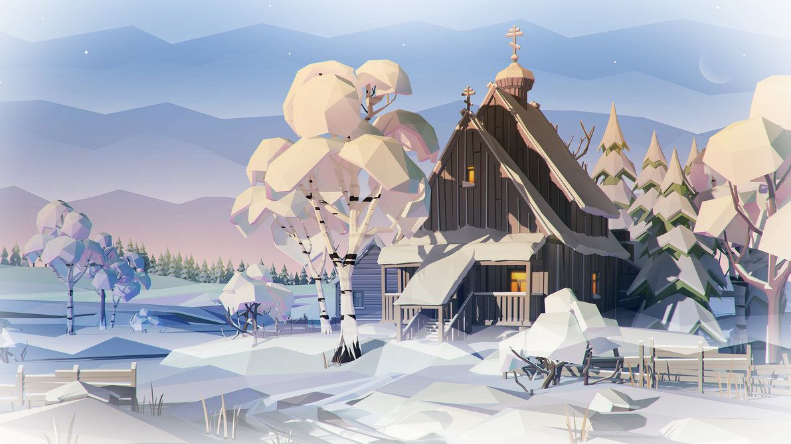


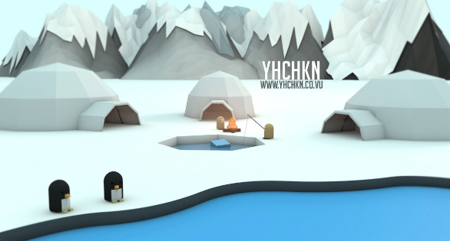
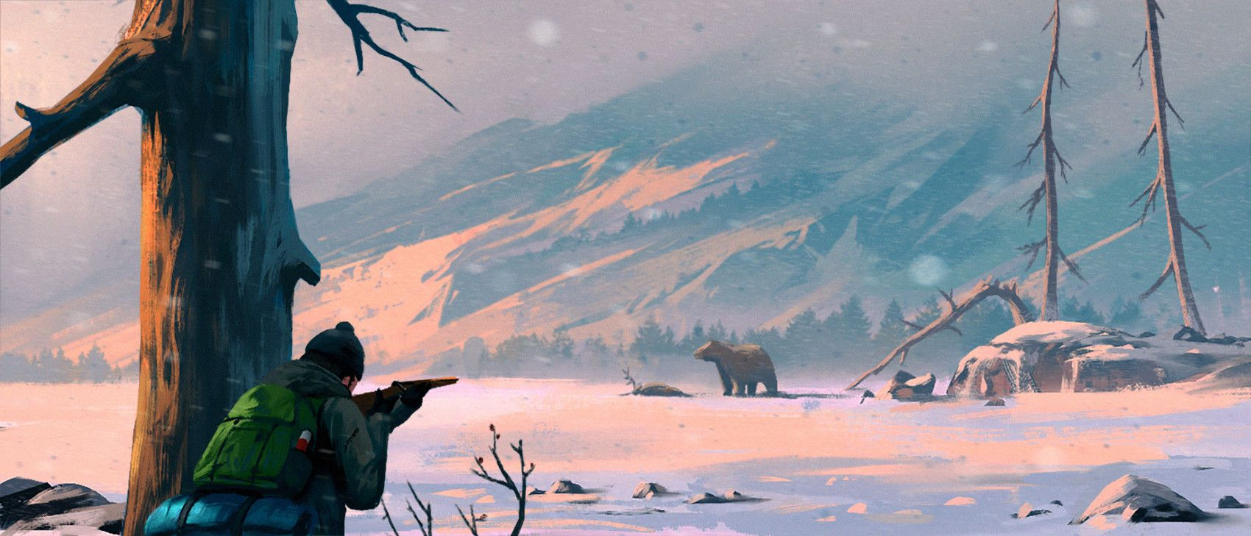

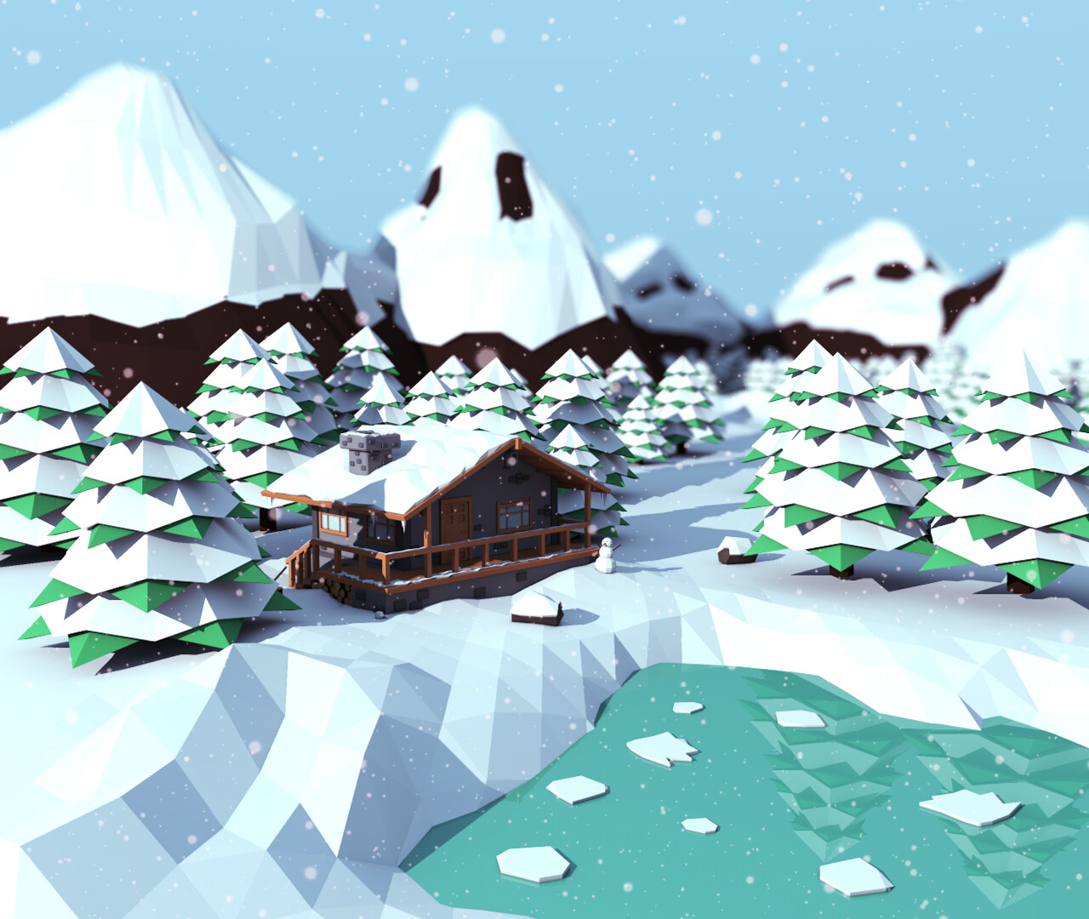
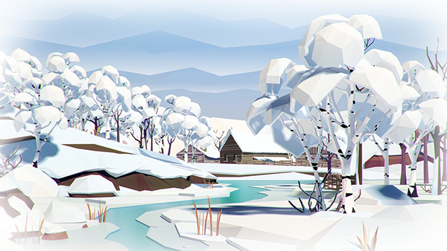
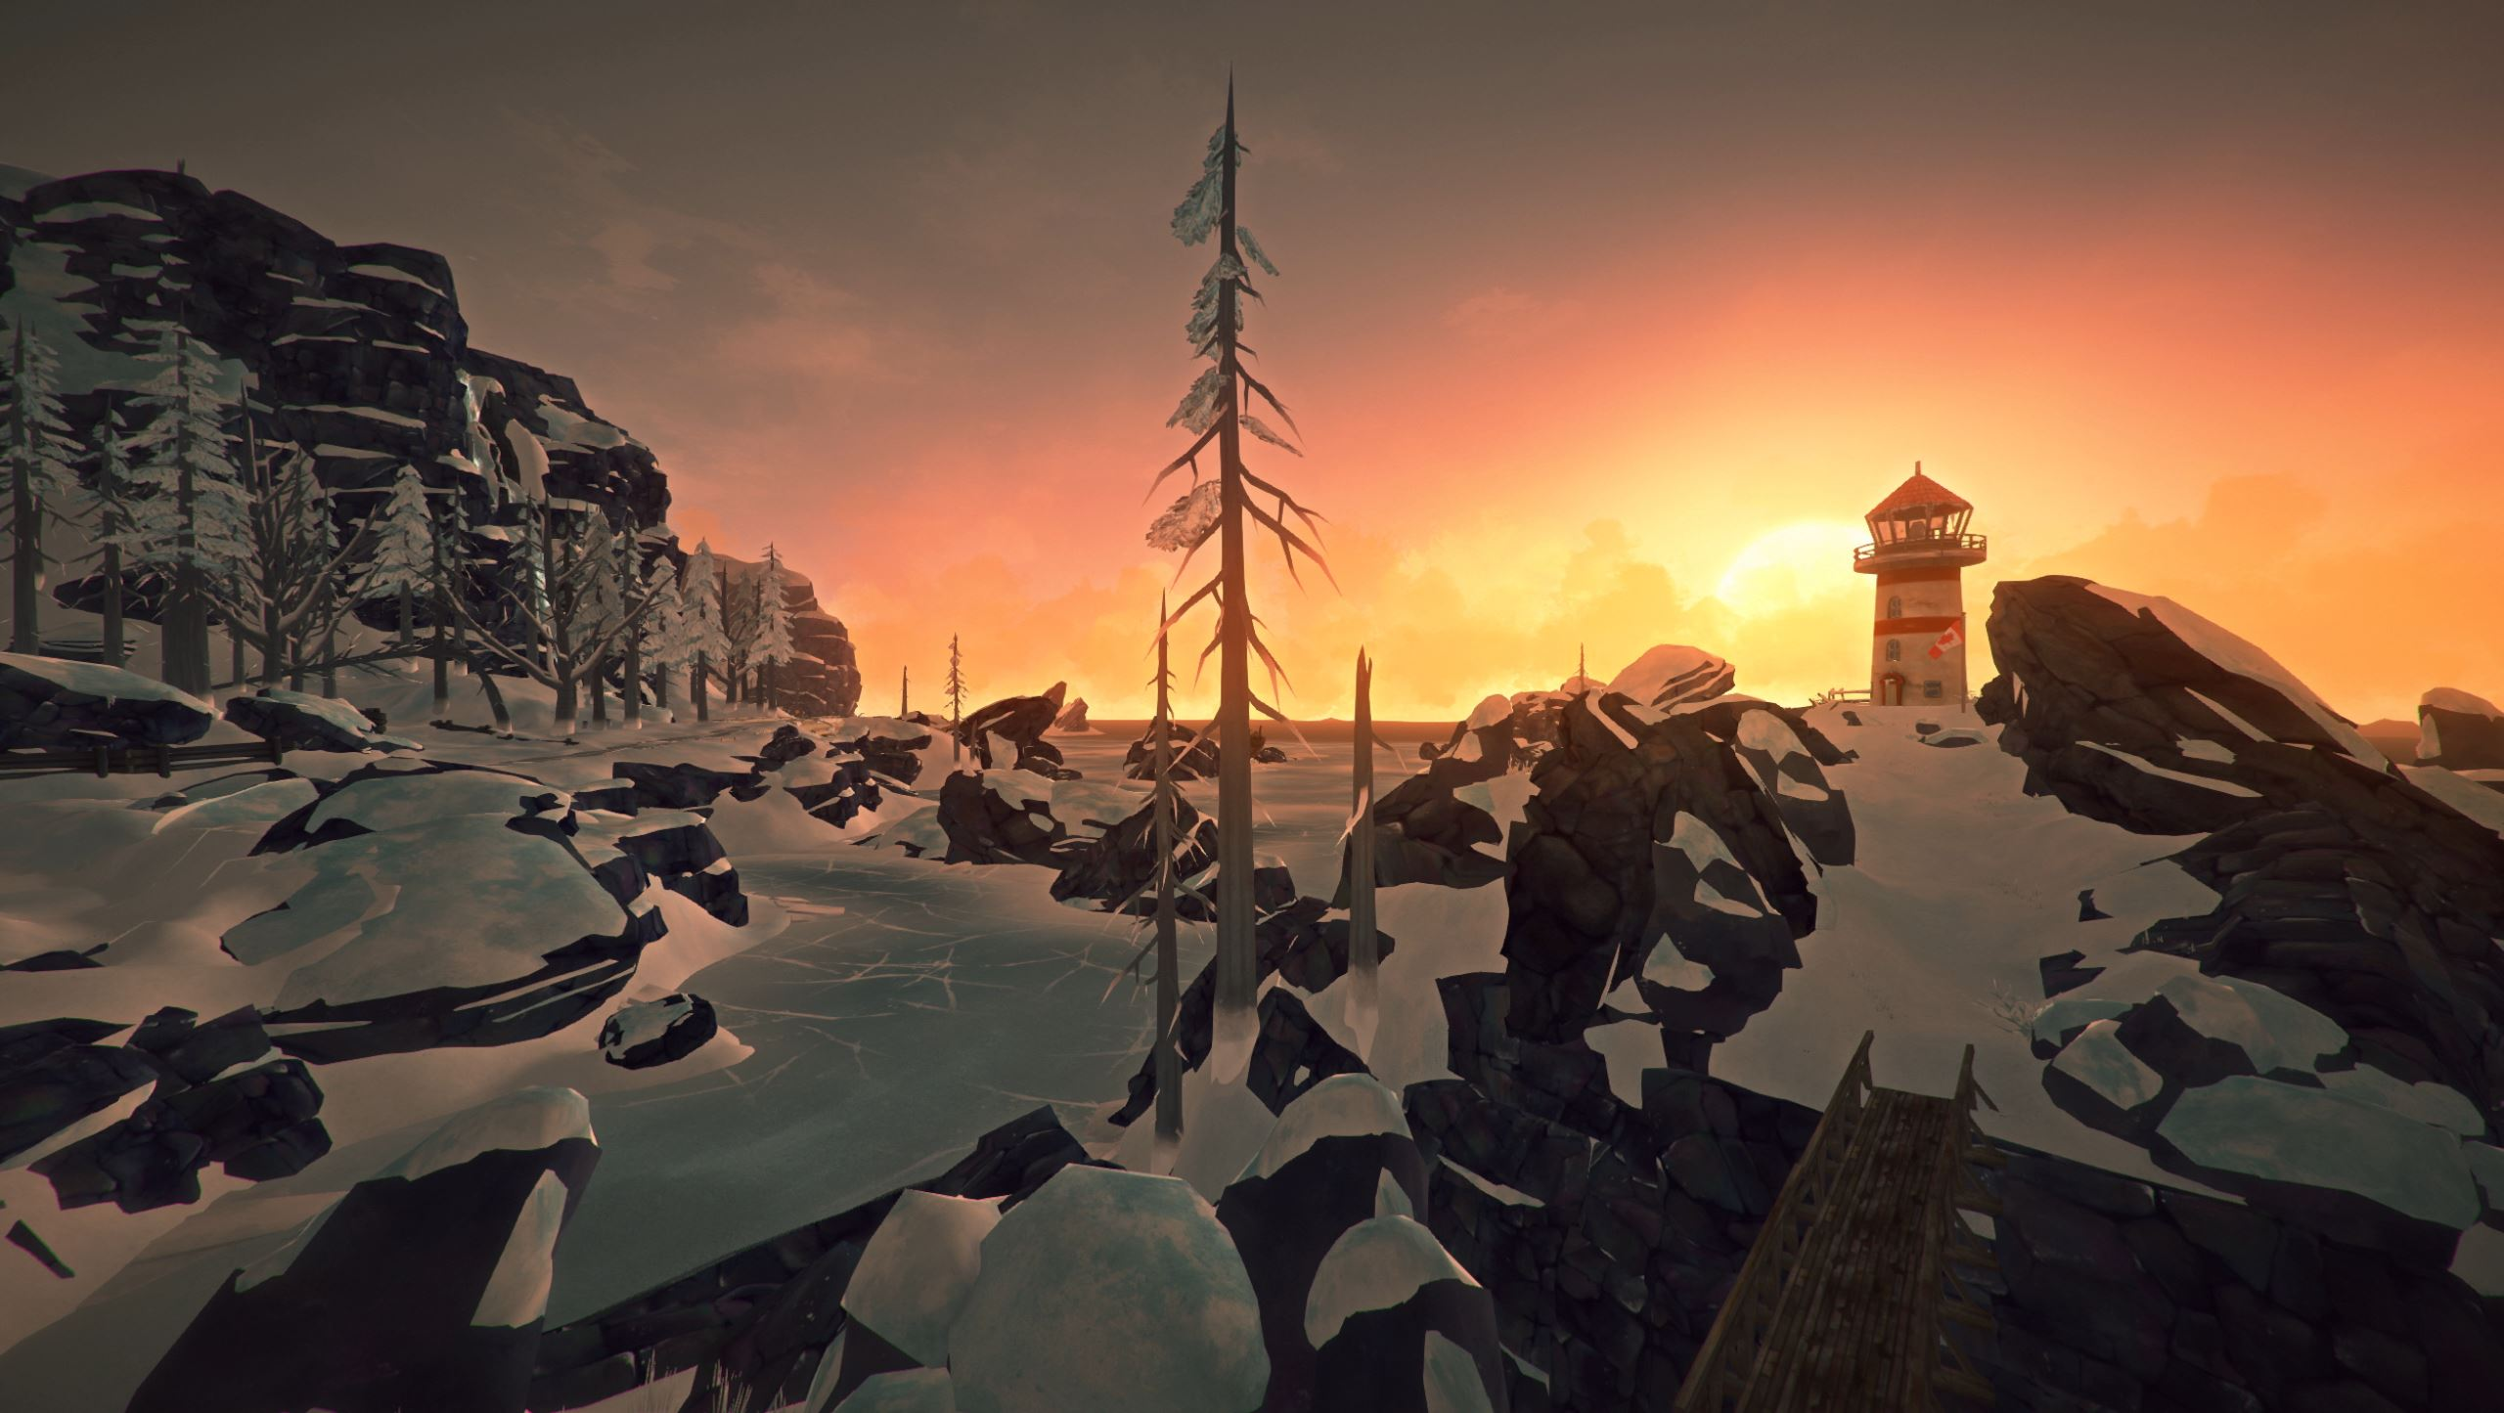

Slide 6
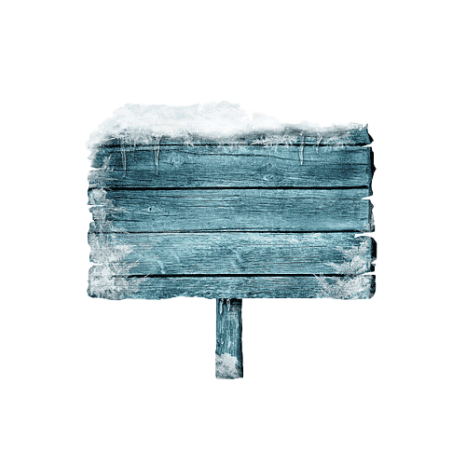
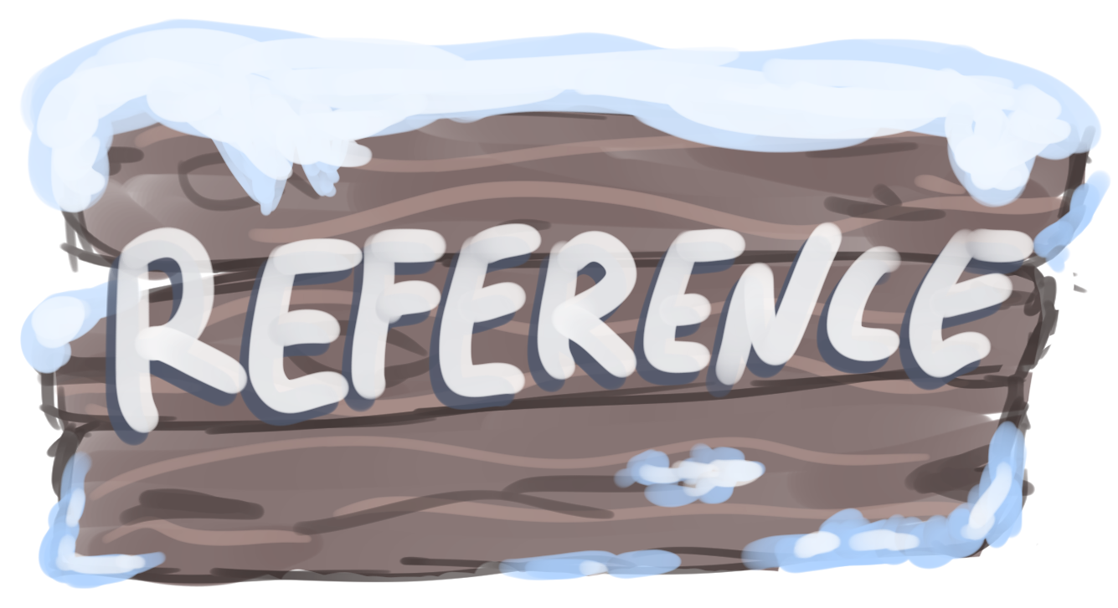


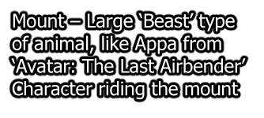
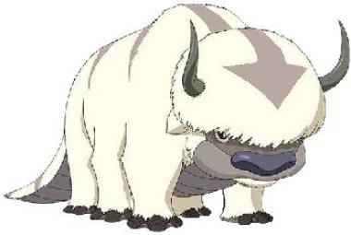
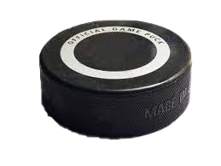
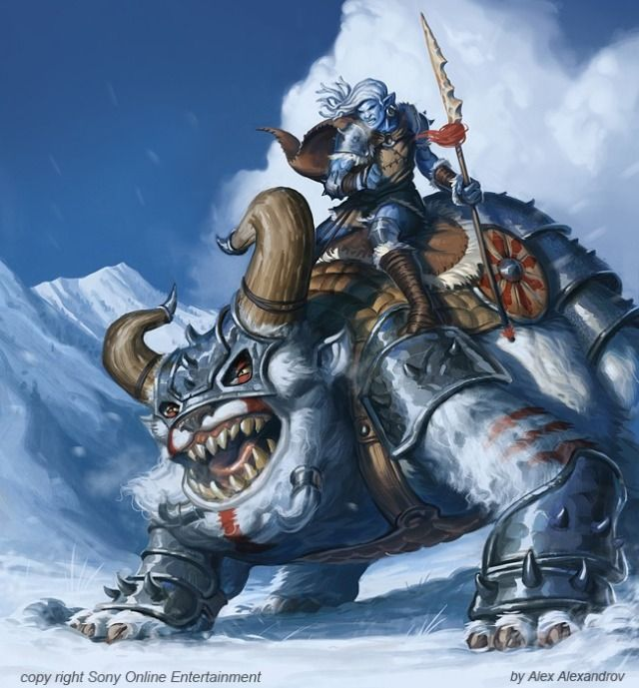
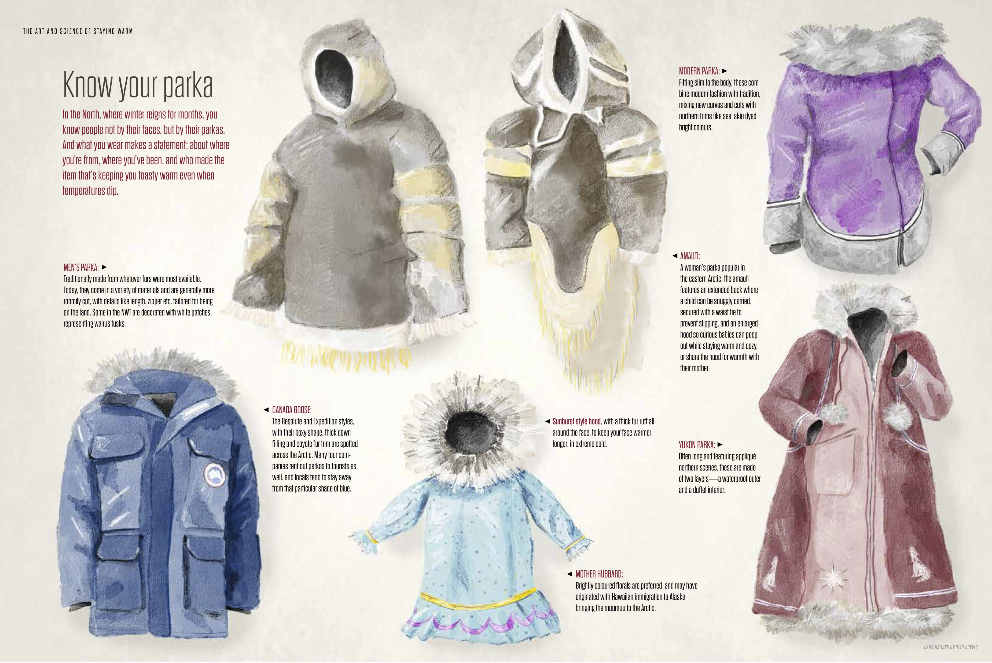
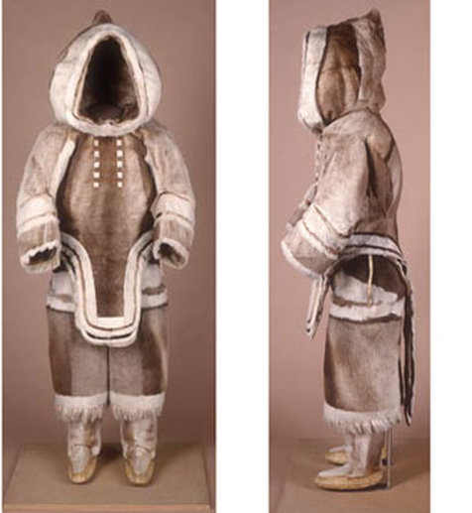
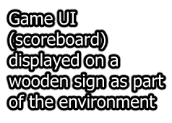
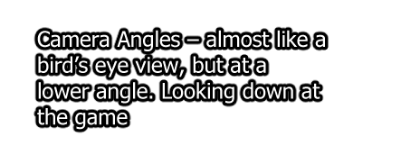
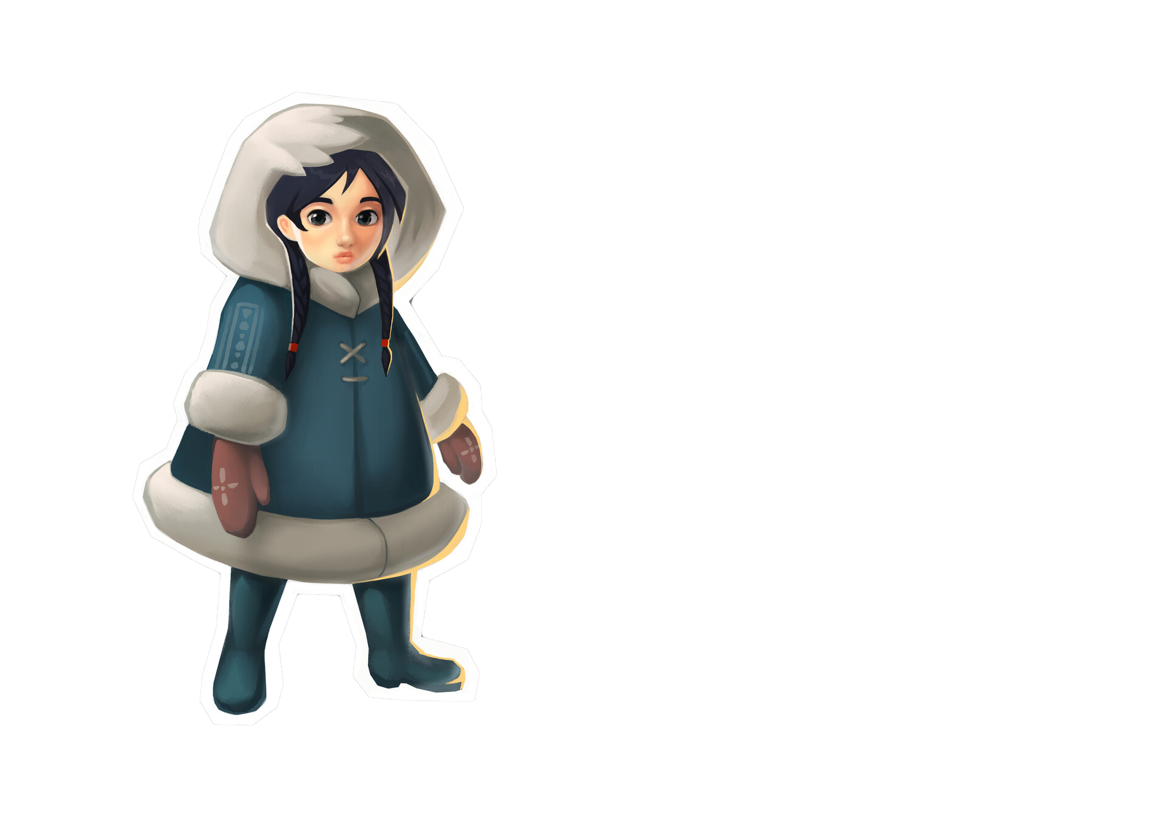
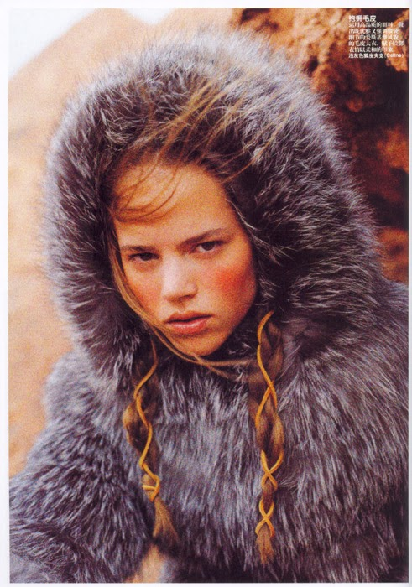
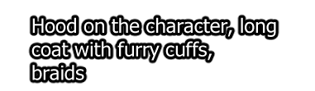

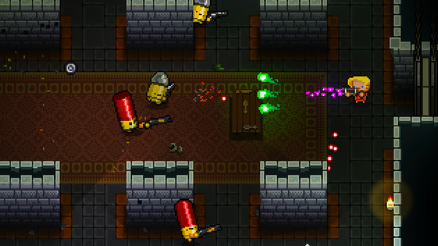
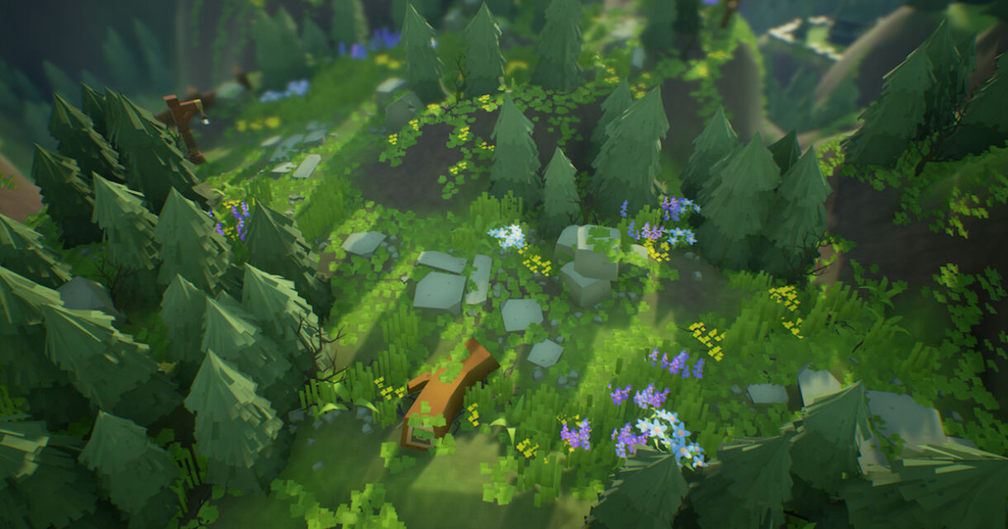

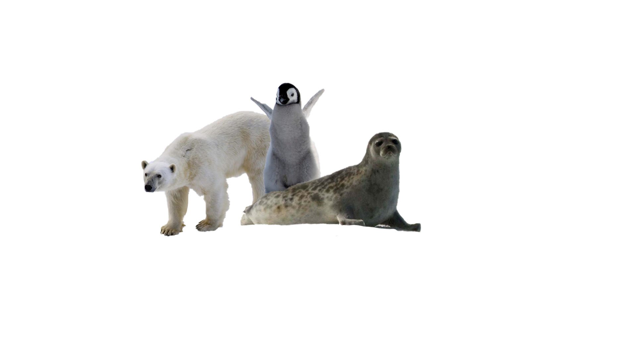

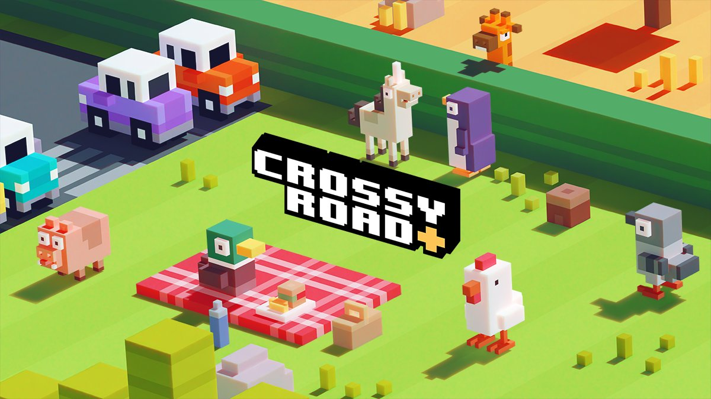
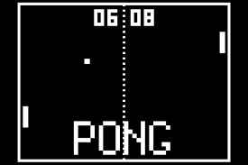
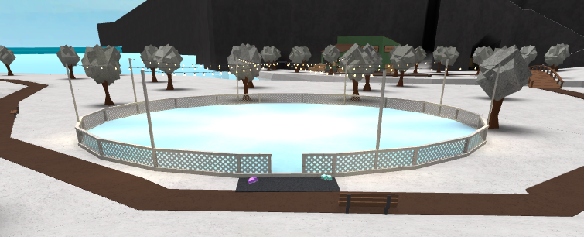

Slide 7

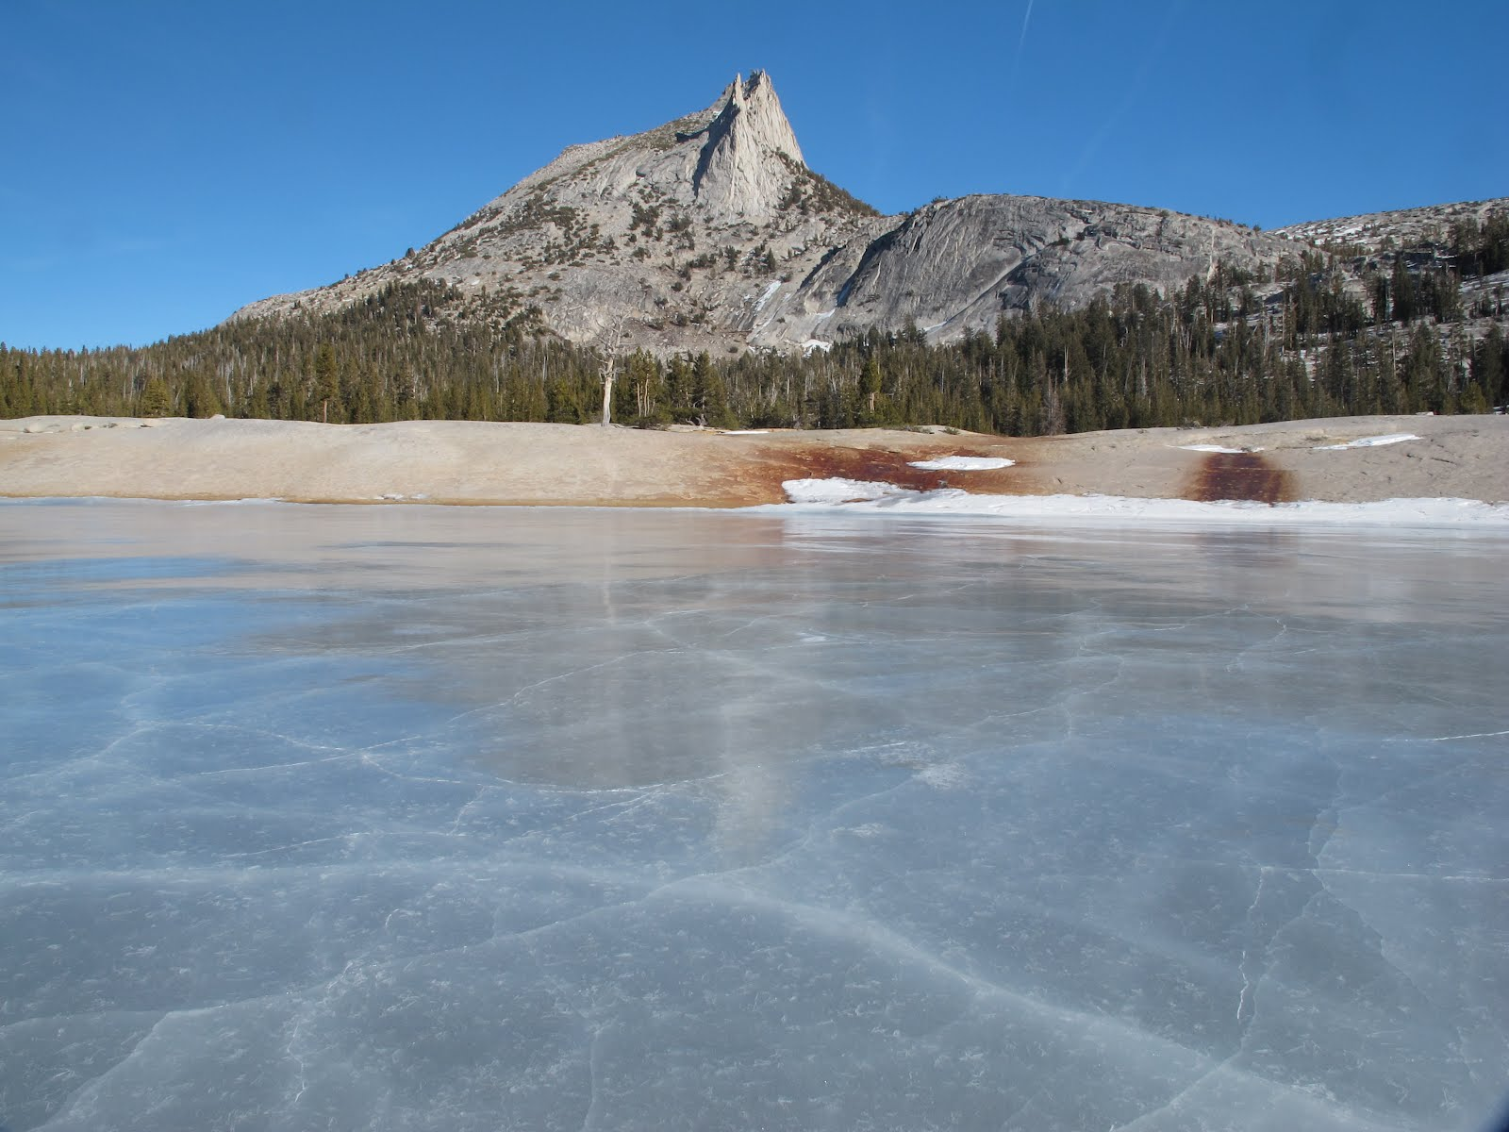
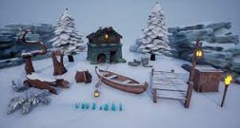
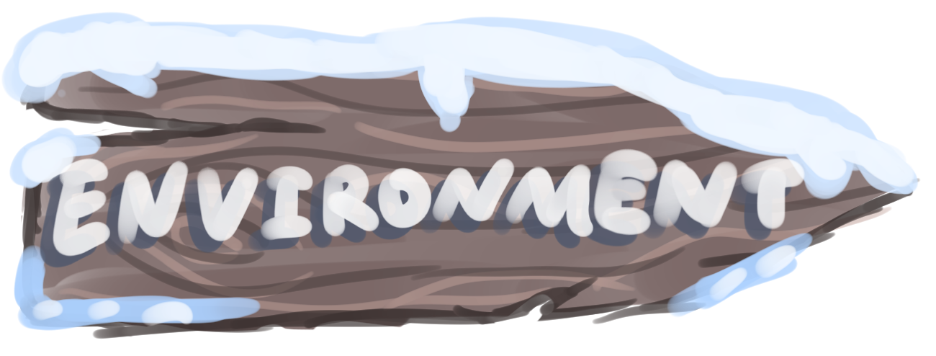
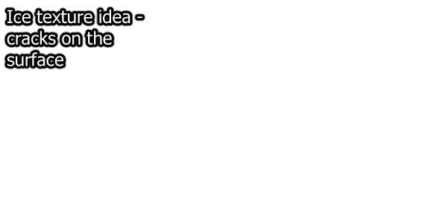
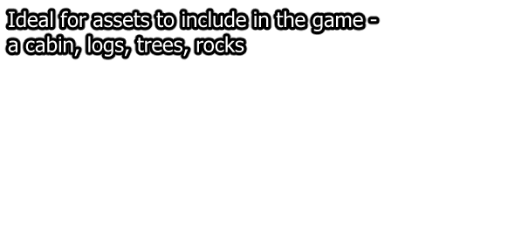











Slide 8

















Slide 9















Slide 10






Slide 11






Slide 12















Slide 13















Slide 14






















Slide 15
















Slide 16









Slide 17





Slide 18

















Slide 19







Colour gradient texture created in Adobe Photoshop. Saved as Targa file
Targa file attached to asset material, asset UVs planar projected in chosen colour gradient
Asset modelled in Maya
Asset exported as an FBX file
Asset placed in engine

Slide 20

Asset Name/Filename | Type | Category | Who | Priority | Notes | Purpose
Snowbeast/Snowbeast.fbx | Art, 3D | Player, Key Asset | Cody | Very High |  | Looks like a polar bear/yeti mix, Players riding ontop of it
Eskimo/Player.fbx | Art, 3D | Player, Key Asset | Anna | Very High | Concept art done by both Cody & Anna | Player Character, rides snowbeast, moves around rink ontop of snowbeast
Oar/Player_Paddle.fbx | Art, 3D | Prop, Key Asset | Anna | Very High | Part of the Snowbeast | Bounces puck, is attached to snowbeasts saddle
Puck/Puck.fbx | Art, 3D | Prop, Key Asset | Cody | Very High |  | Bounces around rink, visually distinct from the environment
Rock/Rock_{ID}.fbx | Art, 3D | Environment | Anna | Medium | Several variants planned
Tree/Tree_{ID}.fbx | Art, 3D | Environment | Cody | Medium | Several variants planned
Cabin/Cabin.fbx | Art, 3D | Environment | Anna/Cody | High | Content split up into multiple objects
Penguin/NPC_Penguin.fbx | Art, 3D | NPC | Cody | High |  | An obstacle to get in the way on the rink
Polar Bear/NPC_Bear.fbx | Art, 3D | NPC | Anna | Low
Seal/NPC_Seal.fbx | Art, 3D | NPC | Anna | Very Low
Snow Pile/Snow_Pile.fbx | Art, 3D | Environment | Anna | Medium | Block of snow as an obstacle?
Cut Log/Log.fbx | Art, 3D | Environment | Cody | Low |  | Used to make bridge between river and arena
GUI Sign | Art, 3D | HUD | Anna | High |  | Sign ingame to display score
Yeti/NPC_Yeti.fbx | Art, 3D | NPC | Anna | Low
Chimney Smoke | Art, 3D, Particles | Environment | Anna | Very Low |  | For log cabin
Snow | Art, 3D, Shaders | Environment, Key Asset | Cody | High | Textures/Shader
Snowbeast Run/Snowbeast_Anim_Run.fbx | Art, Animation | Player, Key Asset | Cody | Very High
Snowbeast Turn/Snowbeast_Anim_Turn.fbx | Art, Animation | Player, Key Asset | Cody | High
Penguin Waddle/NPC_Penguin_Anim_Waddle.fbx | Art, Animation | NPC | Anna | High
Penguin Slide/NPC_Penguin_Anim_Slide.fbx | Art, Animation | NPC | Anna | High |  | Animation for when penguin is the obstacle
Yeti Walk/Yeti_Anim_Walk.fbx | Art, Animation | NPC | Anna | Low
Yeti Pickup/Yeti_Anim_Pickup.fbx | Art, Animation | NPC | Cody | Low
Yeti Throw/Yeti_Anim_Throw.fbx | Art, Animation | NPC | Cody | Low
Water | Art, Mats, Shaders | Environment | Cody | High |  | For river
Ice | Art, Shaders | Environment, Key Asset | Cody | High | Textures/Shader - different shades of ice so that the ice rink can easily be differentiated

